Slide 1
Dissertation Proposal: User Interfaces for the Coq Proof Assistant
Benjamin Berman

Slide 2
Outline
My general goals
Theorem Proving with Coq
Briefly go through an example
Survey—evidence of room for improvement
Research Plans
CoqEdit + Extensions
Include some of the evolution of the ideas
Context
User testing
Rough timeline for research

Slide 3
General Goals (1/2)
Improve usability of the Coq Proof Assistant
Coq is a tool for developing and checking proofs
Coq and similar tools are being used to formalize general mathematics
Coq and similar tools are playing an important role in the development of more reliable computing systems
It is based on a language using more sophisticated types
One can use it to model and reason about software and hardware specifications and implementations
Coq and similar tools can be used as an educational tool
Students get more-immediate feedback
Machine-checked proofs help ensure that all the necessary details are there when students are trying to understand theorems/proofs
Still somewhat difficult with Coq
Tool needs to be taught
Not always a lot of feedback
Benjamin Pierce’s Software Foundations provides a model

Slide 4
General Goals (2/2)
Improve usability of coding environments
Coq is also a program development tool
You can define functions, declare variables, etc.
You can prove theorems regarding these programs
Surprisingly, the proofs you create correspond to programs
Proof development mechanism becomes an alternative way to develop programs
Coq has many complexities and therefore many opportunities for designing helpful interfaces
Coq’s language pushes at the edges of what is considered practical
By making Coq easier to use, we are expanding the range of practical programming languages

Slide 5
Theorem Proving with Coq
Two main existing user interfaces
CoqIde
Proof General
General idea behind both:
Send “sentences” from text area to the coqtop command prompt
Possibly undo the effects of evaluation
Highlight sentences that have been/are being evaluated
Report results of evaluation in one of two additional windows

Slide 6
Theorem Proving with Coq
An (very simple) example:
Prove that,
(A -> B -> C) -> (A -> B) -> A -> C
where A, B, and C are “Prop”s.
Note that this is equivalent to
(A -> (B -> C)) -> ((A -> B) -> (A -> C))
An un-curryed version, + some extra whitespace, might be most natural:
((A /\ B) -> C) /\ (A -> B))
-> (A -> C)

Slide 7
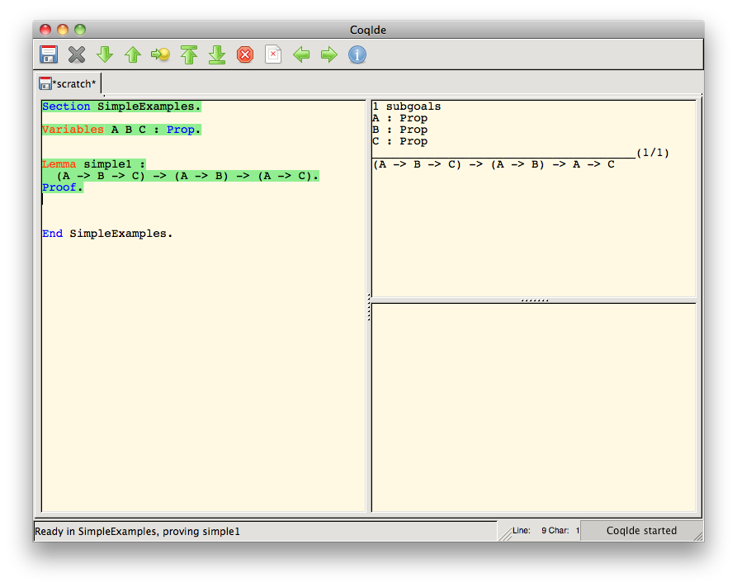
Theorem Proving with Coq: Get Things Set Up

Slide 8

Theorem Proving with Coq: Enter & Evaluate Tactics

Slide 9
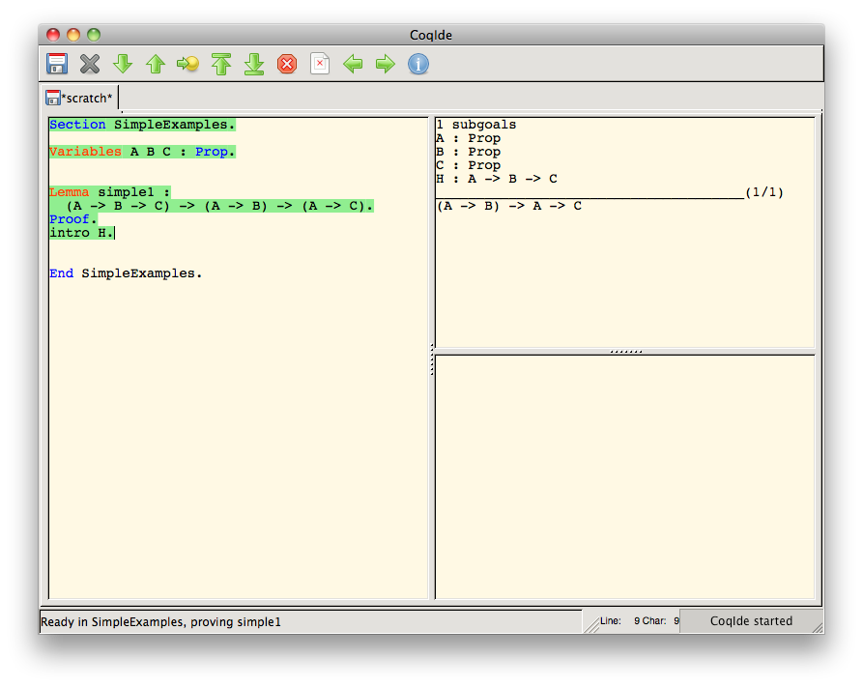
Theorem Proving with Coq: Enter & Evaluate Tactics

Slide 10
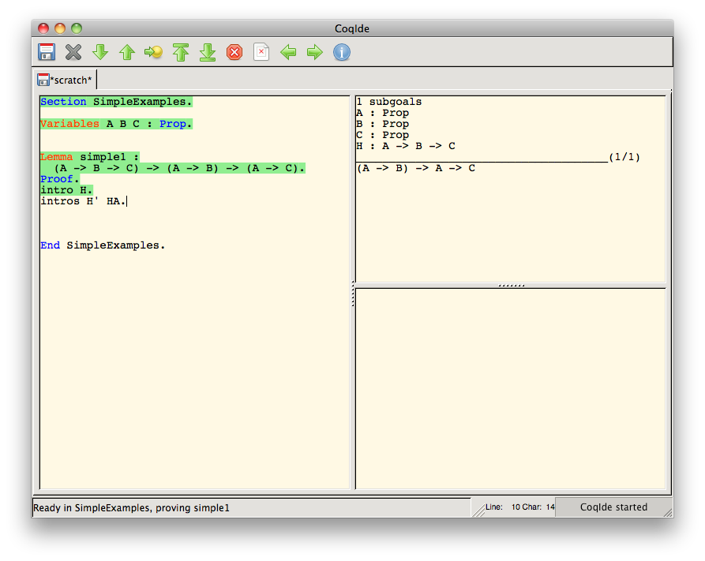
Theorem Proving with Coq: Enter & Evaluate Tactics

Slide 11
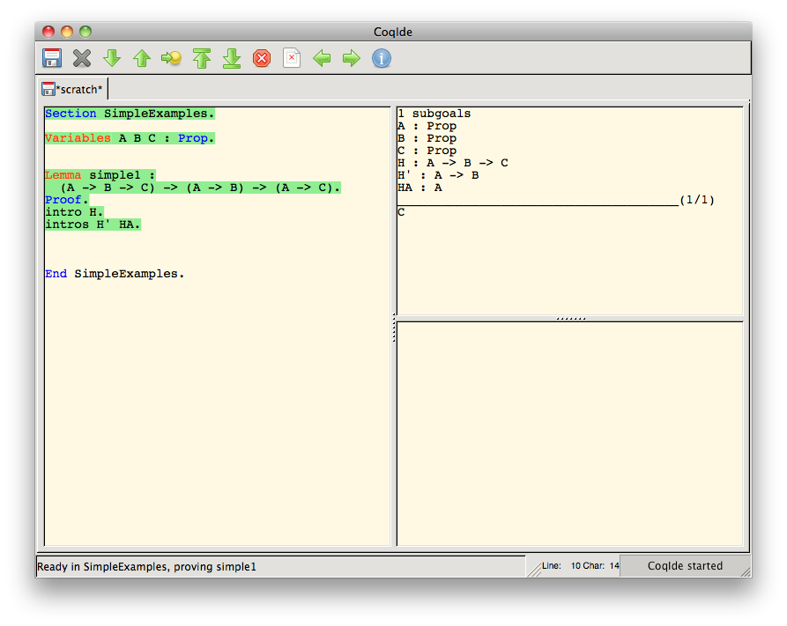
Theorem Proving with Coq: Enter & Evaluate Tactics

Slide 12

Theorem Proving with Coq: Enter & Evaluate Tactics

Slide 13
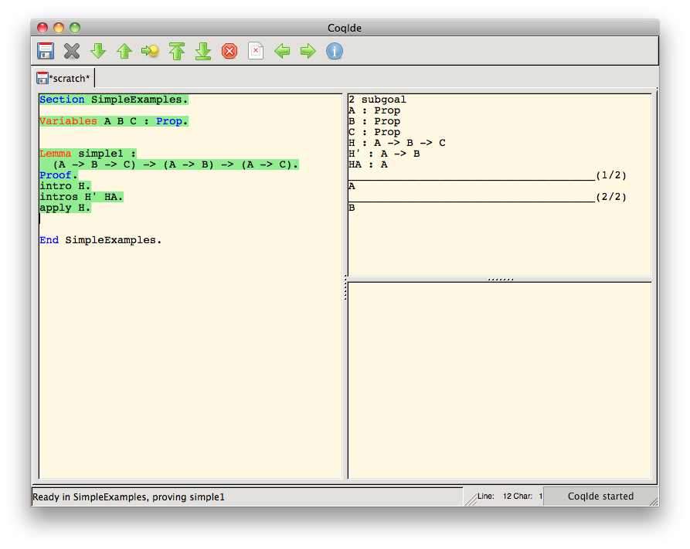
Theorem Proving with Coq: Enter & Evaluate Tactics

Slide 14

Theorem Proving with Coq: Enter & Evaluate Tactics

Slide 15
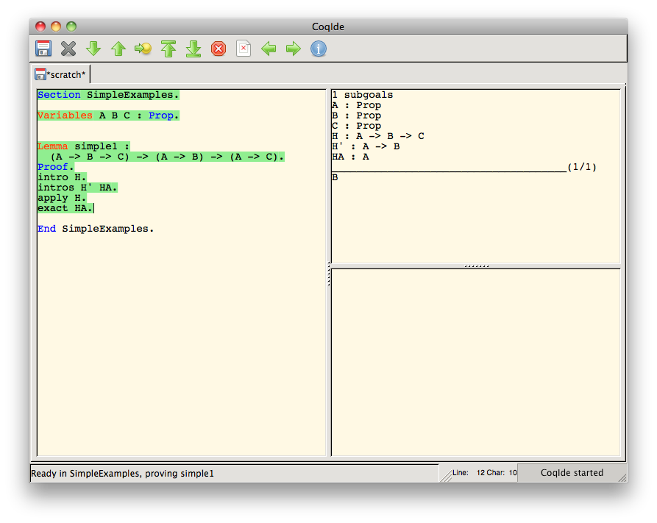
Theorem Proving with Coq: Enter & Evaluate Tactics

Slide 16

Theorem Proving with Coq: Enter & Evaluate Tactics

Slide 17
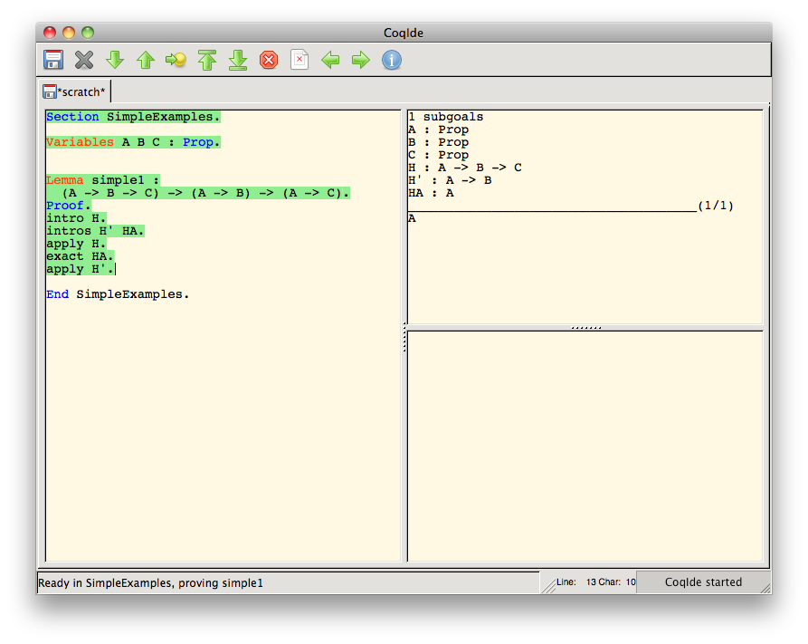
Theorem Proving with Coq: Enter & Evaluate Tactics

Slide 18
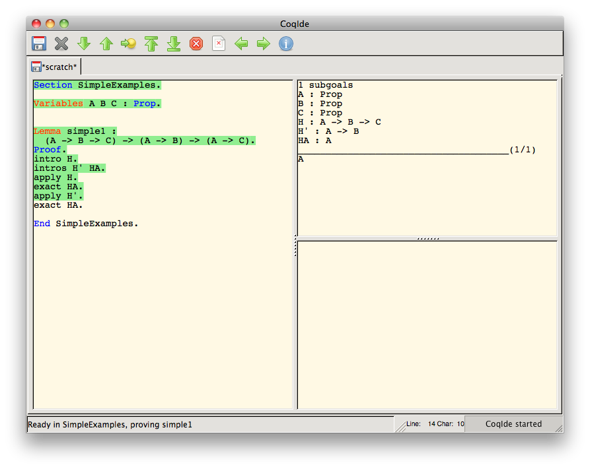
Theorem Proving with Coq: Enter & Evaluate Tactics

Slide 19
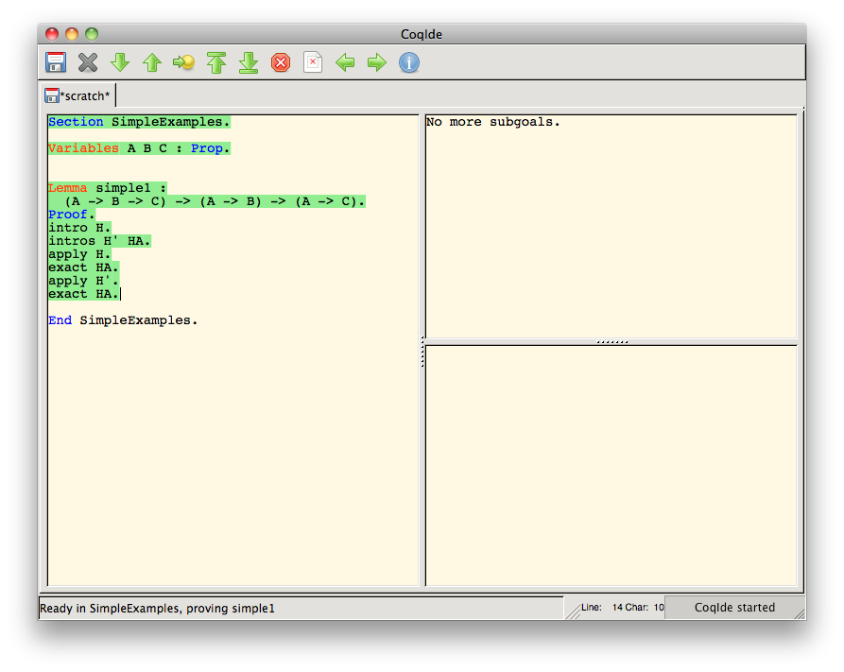
Theorem Proving with Coq: Enter & Evaluate Tactics

Slide 20

Theorem Proving with Coq: Final Check and Saving of Proof

Slide 21
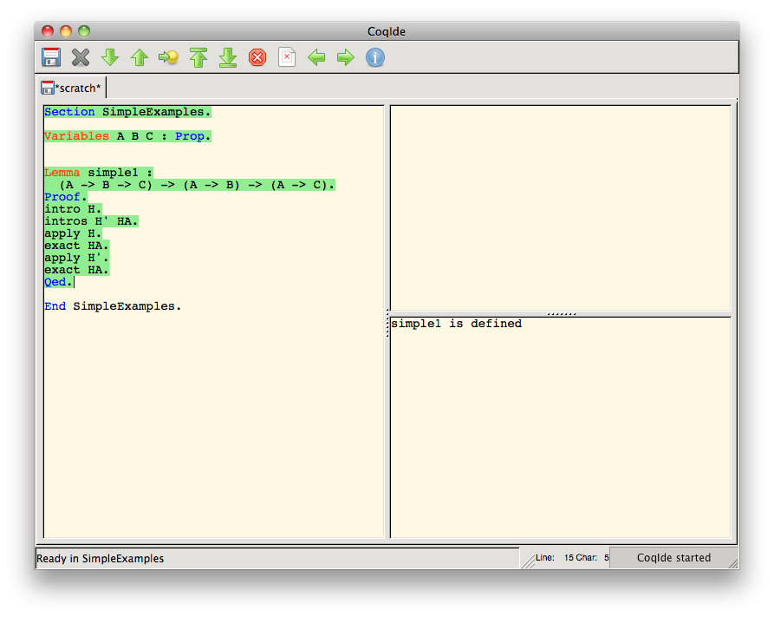
Theorem Proving with Coq: Final Check and Saving of Proof

Slide 22

Theorem Proving with Coq: Closing off the Section

Slide 23
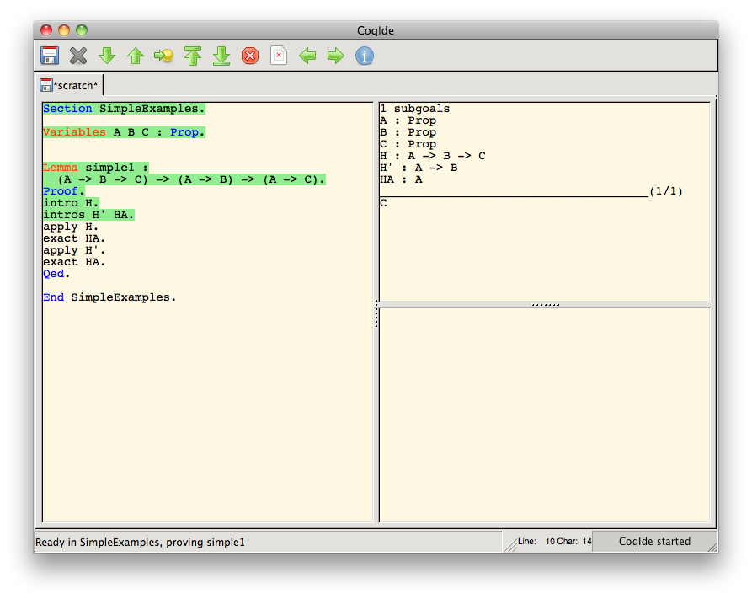
Theorem Proving with Coq: Moving Back

Slide 24
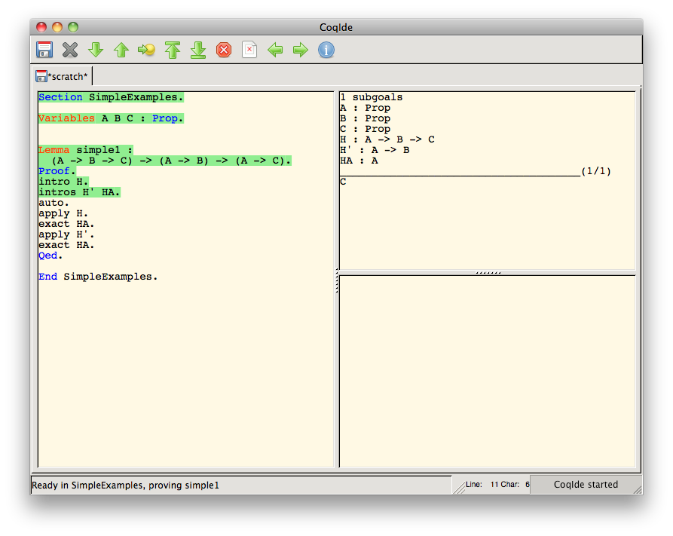
Theorem Proving with Coq: Automatically Proving the Lemma

Slide 25
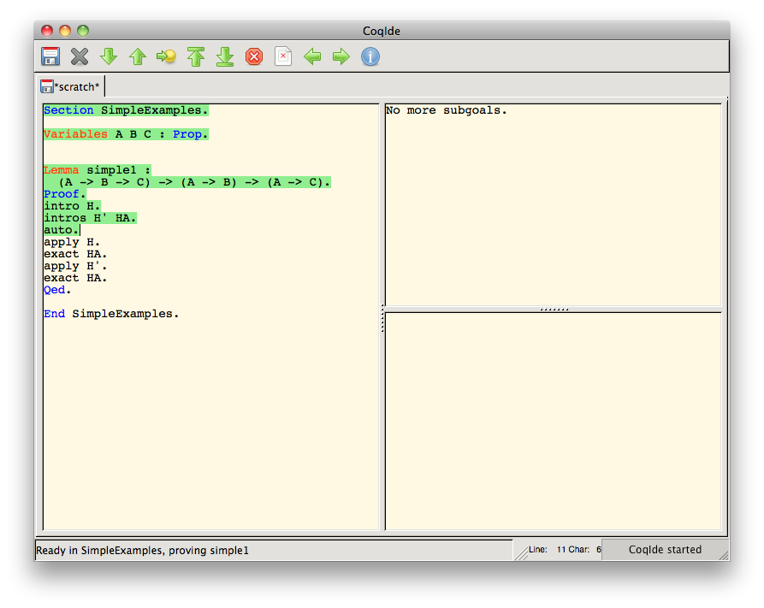
Theorem Proving with Coq: Automatically Proving the Lemma

Slide 26
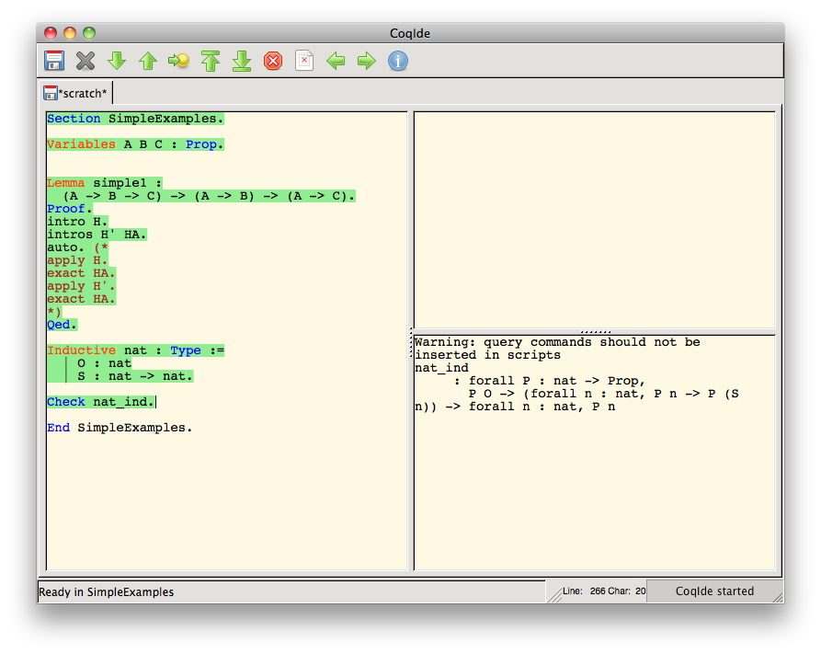
Theorem Proving with Coq: Natural Numbers

Slide 27
What the example shows (or, at least, what it starts to)
One of the big tasks for Coq users is to figure out what these tactics do
This task is challenging for several reasons
There are lots of tactics whose effects are dependent upon the given arguments and goals
Seeing the effects of tactics requires awkward movement through the proof script
There is a lot of black and white that has to be sorted through

Slide 28
Survey
There are lots of other problems to face, including ones for expert users
To verify this, a survey was sent to Coq-Club mailing list subscribers
48 responses
Almost 4,500 words in response to the essay questions

Slide 29
Survey
My general impression from the responses:
Appreciation of existing interfaces
Some specific tasks we identified as difficult were indeed perceived as difficult, including
understanding the relationships between subgoals
switching back and forth between potential subgoal proofs
comparing similar subgoals
telling what options are available for proving a subgoal
Many helpful features could be added, in particular:
features seen in programming IDEs, like refactoring
representation of proof structure

Slide 30
Survey
The responses to the survey come largely from active Coq users
This strengthens the conclusion that there is plenty of room for user interface improvement

Slide 31
Research Plans
Develop CoqEdit
CoqEdit is a plugin to jEdit
jEdit is a fully-featured open source text editor written in Java
Basic version is similar to Proof General and CoqIde
Designing it to be extended
jEdit has a plugin dependency mechanism, which allows plugins for plugins
I have been working on it with Harley Eades
I am currently working on a major revision of an initial version
Fix a few bugs
Implement a few remaining features
Adds better support for cached output, viewing multiple files/file positions
Better support in the software architecture for extendibility

Slide 32
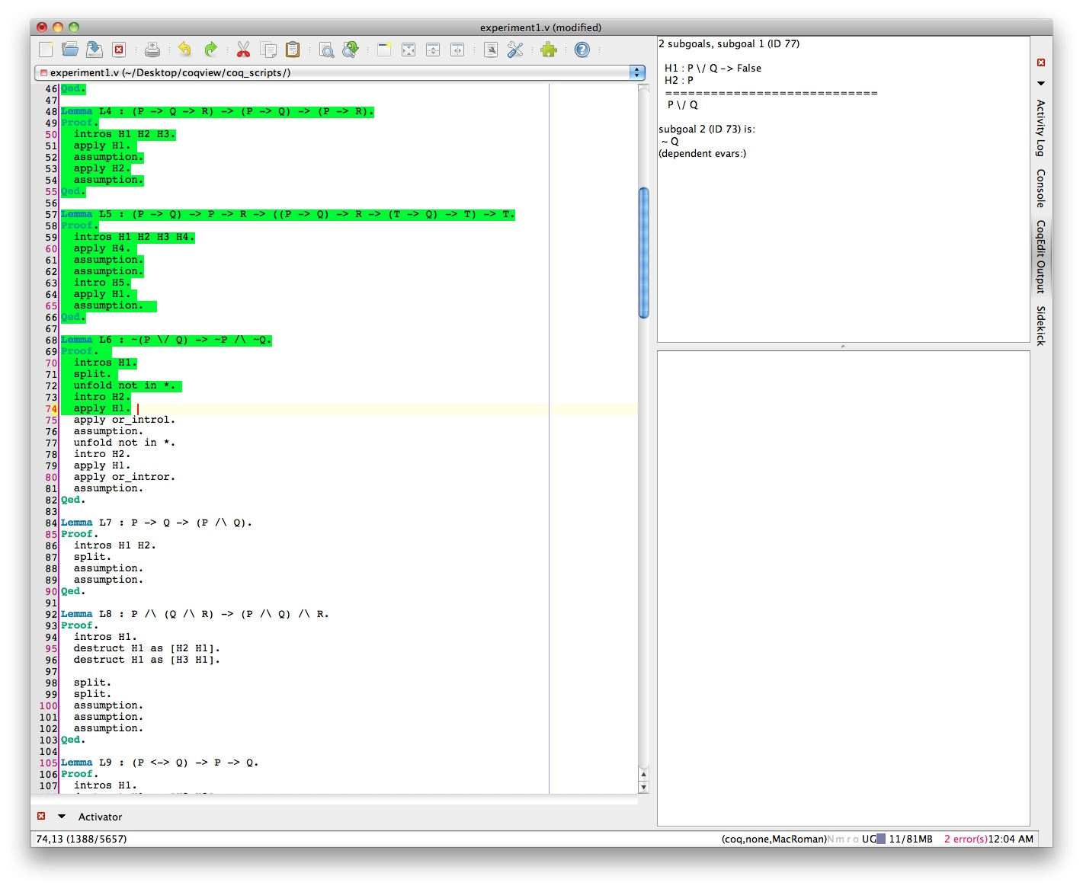
CoqEdit, initial version

Slide 33
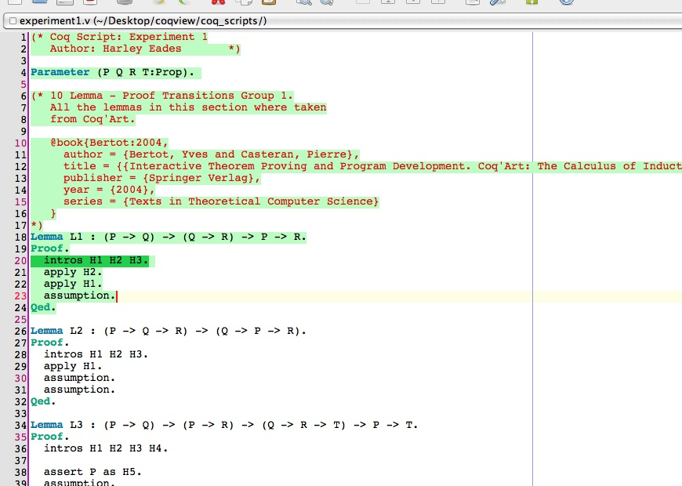
CoqEdit, in-progress revision

Slide 34
Research Plans
Develop three CoqEdit extensions
Will be for mostly experimental purposes
Want to demonstrate CoqEdit extendibility
Want to develop and test potential improvements

Slide 35
Extension #1: “Proof Previews”
Generate lists of tactics that do not produce errors (immediately)
Allow users to toggle through this list and immediately see the results of evaluating the tactic

Slide 36
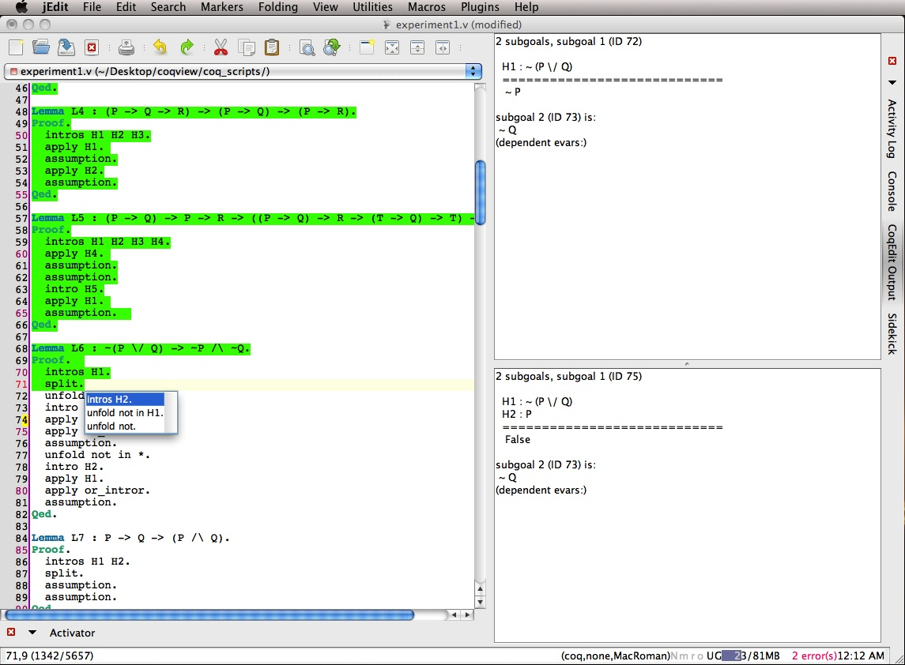
Extension #1: “Proof Previews”

Slide 37
Extension #2: “Proof Transitions”
Evolved from two ideas
Proof tree visualization
Inference rule highlighting

Slide 38
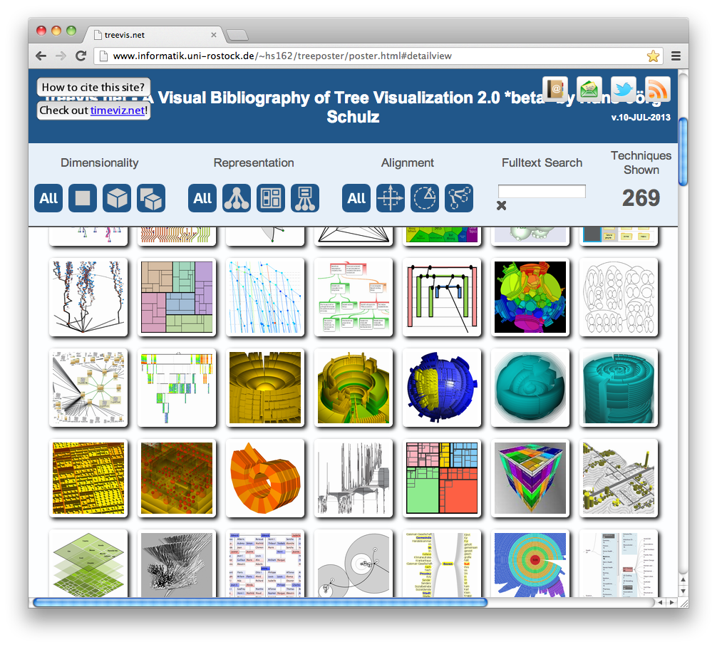
Proof tree visualization
Lots of ways of visualizing trees:
Schulz, H., "Treevis.net: A Tree Visualization Reference," Computer Graphics and Applications, IEEE , vol.31, no.6, pp.11,15, Nov.-Dec. 2011 doi: 10.1109/MCG.2011.103

Slide 39
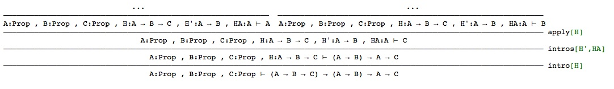
Proof tree visualization
Traditional way of drawing “proof trees”:
Visualization created with ProofWeb. http://prover.cs.ru.nl/.

Slide 40
Proof tree visualization
The previous visualization gets a bit messy. Instead,
“Overview first”
“Details on demand”
Ben Shneiderman, The Eyes Have It: A Task by Data Type Taxonomy for Information Visualizations. In Proceedings of the IEEE Symposium on Visual Languages, pages 336-343, Washington. IEEE Computer Society Press, 1996
Notes:
From the “visual information-seeking mantra”

Slide 41
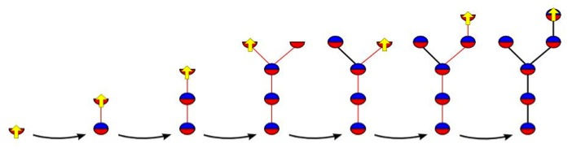
Proof tree visualization

Slide 42
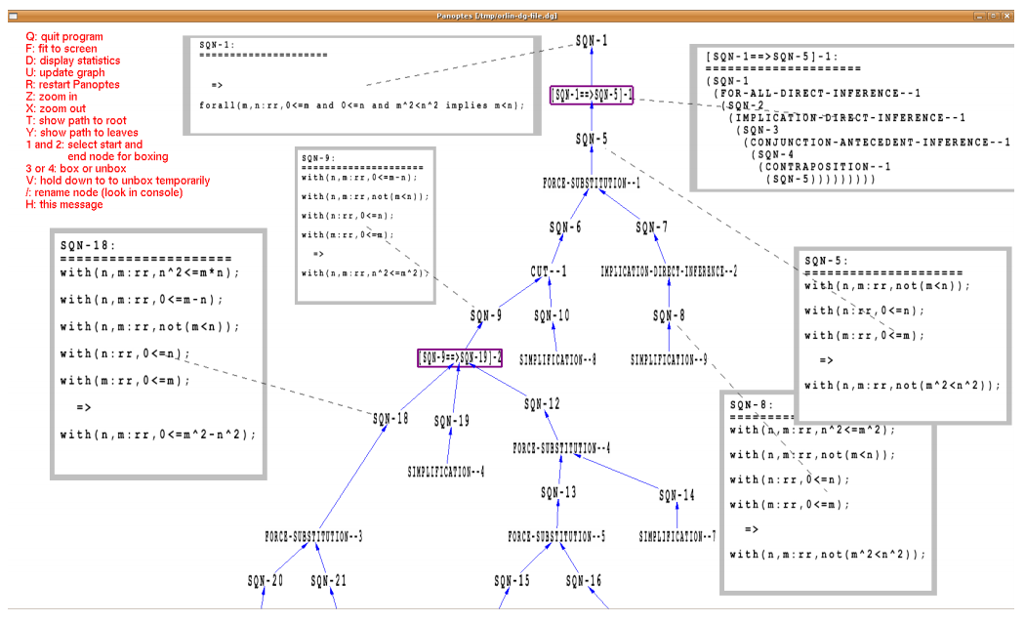
Proof tree visualization
William M Farmer and Orlin G Grigorov. Panoptes: An exploration tool for formal proofs. Electronic Notes in Theoretical Computer Science, 226:39–48, 2009.
Notes:
I should note that this sort of visualization has been done before, albeit with some limitations. For instance, here we see a visualization, created using a tool called Panoptes, of a proof developed using the IMPS theorem prover.

Slide 43
Inference rule highlighting
Goal 1: Show where statements get moved when you enter a tactic
Goal 2: Show how the movement of statements fits the pattern of the inference rule associated with the tactic

Slide 44
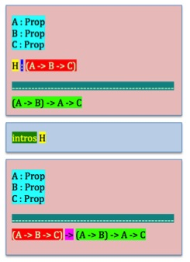
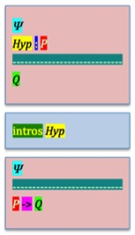
Inference rule highlighting
Notes:
The goals here are to first to show where things get moved around when one enters a tactic and
There are several problems with this here. First of all, it is not actually that easy to find matching colors

Slide 45
Inference rule highlighting
Roadblock 1: it is not so easy to find matching colors
Roadblock 2: eventually we run out of easily distinguishable colors
Roadblock 3: many tactics, like “auto” do not really correspond to simple patterns

Slide 46
Inference rule highlighting
Solution Step 1: Ignore Goal 2 and rename the user interface feature.

Slide 47
Inference rule highlighting Proof Transitions
Solution Step 1: Ignore Goal 2 and rename the user interface feature.
Solution Step 2: Limit the number of highlighting colors to just 3
Red for text that disappears
Green for new text
Yellow for text that is moved/copied
Solution Step 3: Use animation to show where text is moved/copied

Slide 48
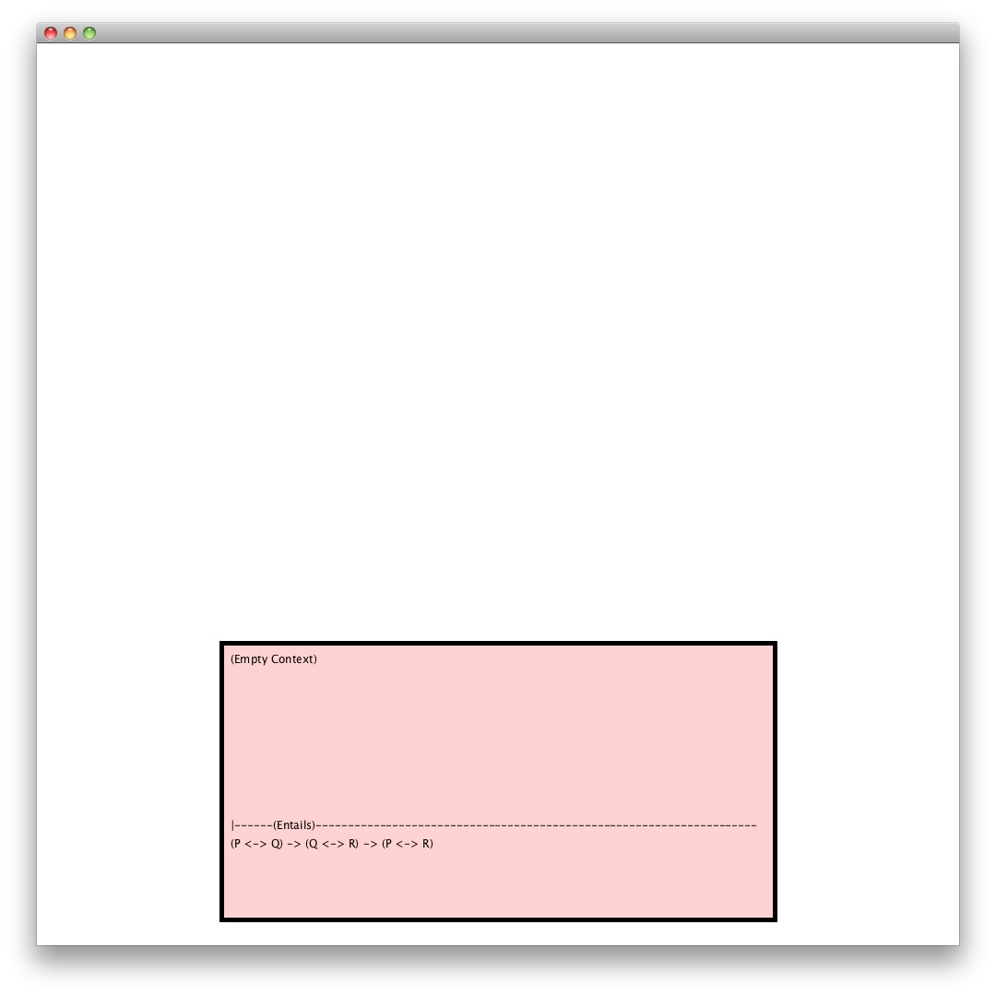
Proof Transitions
Notes:
Here’s my initial stab at implementing this. Starting with our current goal…

Slide 49
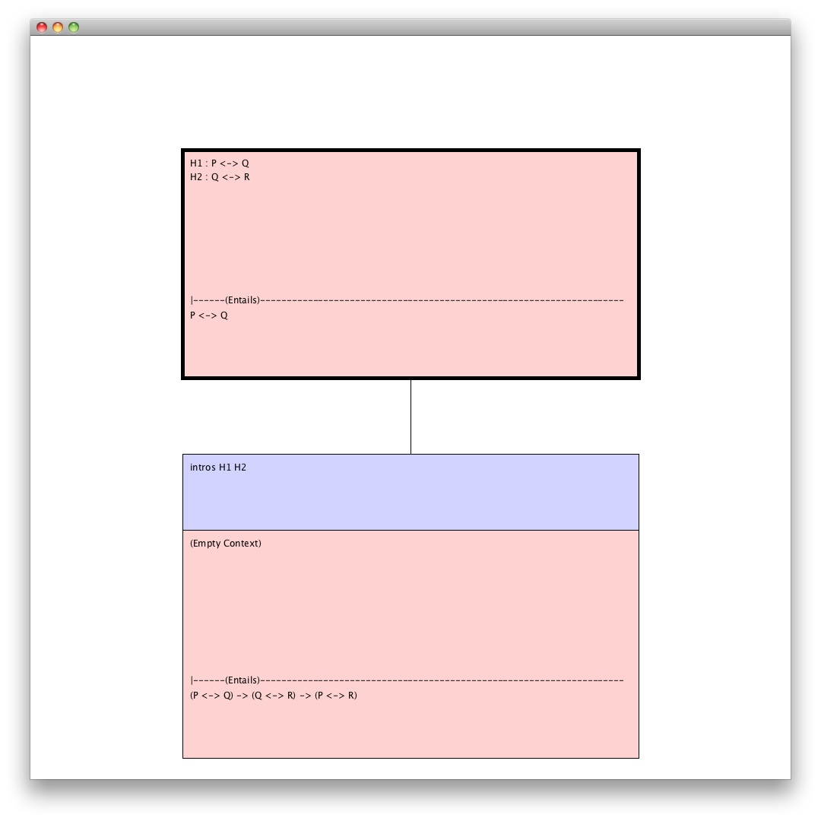
Proof Transitions
Notes:
…we enter a tactic and see the new current goal drawn directly above.

Slide 50
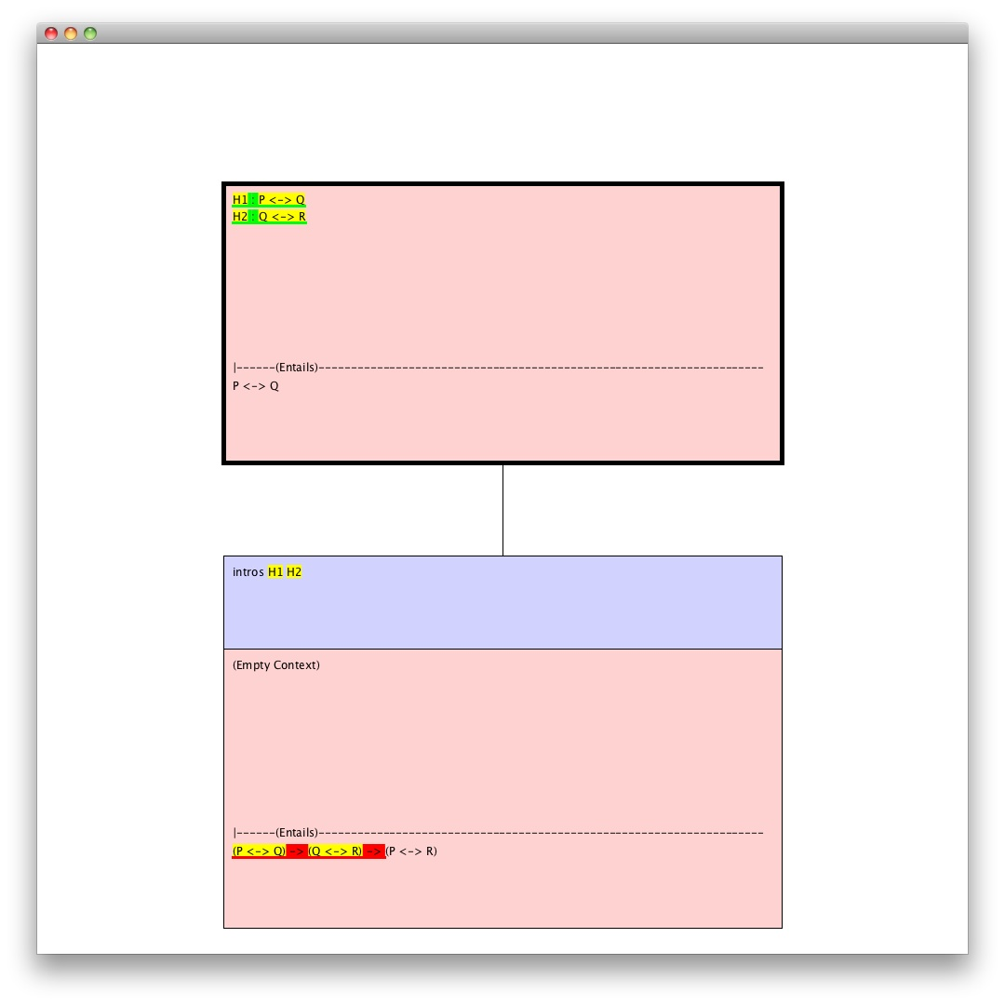
Proof Transitions
Notes:
Then, optionally, the user could add highlighting as described earlier…

Slide 51
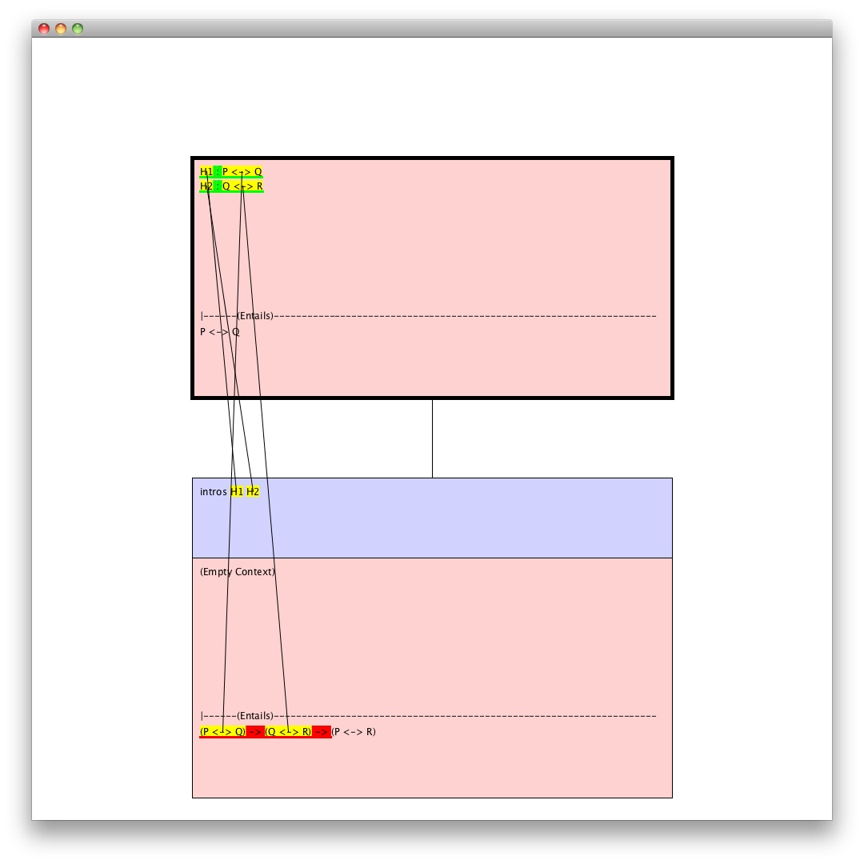
Proof Transitions
Notes:
…and add some animation, like lines that appear one by one, to show where text has been moved. I may actually use floating text to show this.

Slide 52
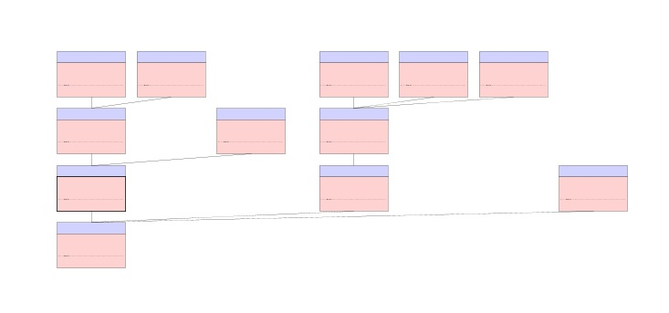
Proof Transitions
Notes:
What’s nice about the library I’m using to implement this is that we can easily allow the user to zoom out to see the structure of the tree as well as the contents of the nodes.

Slide 53
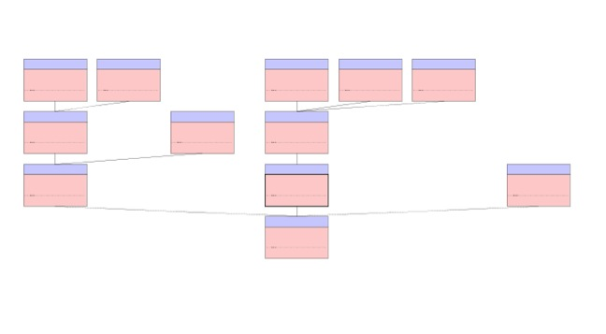
Proof Transitions
Notes:
We can also allow the user to move the current node to, say, a sibling, while keeping it centered above its parent by automatically rearranging nodes

Slide 54
Extension #3: “Propositional Logic Syntax Shortcuts”
Also a combination of two ideas
Syntax Tree Highlighting
Keyboard-Card Menus

Slide 55
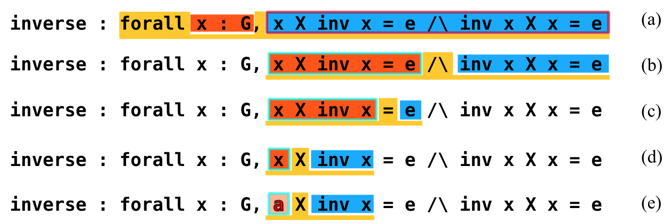
Syntax Tree Highlighting
Select sub-expressions
Show sub-expression types/unfold
Clarify notation precedence/associativity
Notes:
Navigate, inspect and manipulate syntax trees just as you do proof trees.

Slide 56
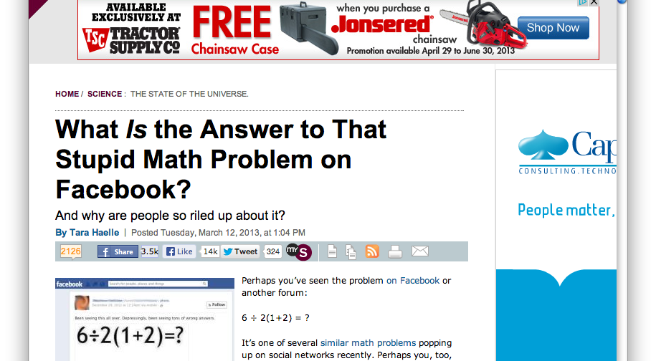
Helping People Parse Generalizes
Notes:
I find it kinda funny when I see this outside of programming/cs

Slide 57
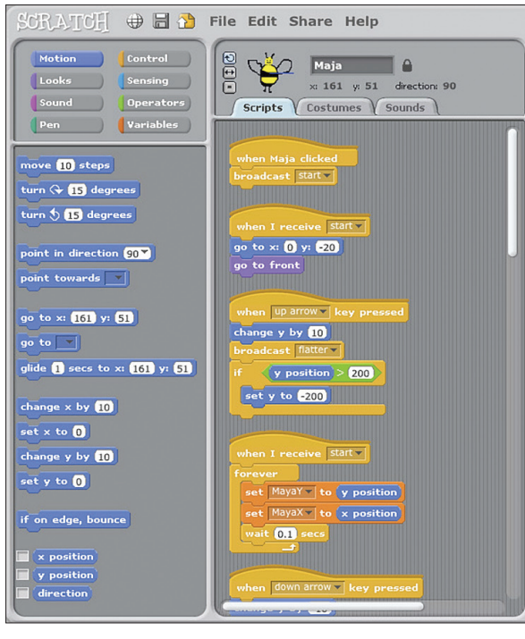
Related System: “Scratch”
Mitchel Resnick, John Maloney, Andrés Monroy-Hernández, Natalie Rusk, Evelyn Eastmond, Karen Brennan, Amon Millner, Eric Rosenbaum, Jay Silver, Brian Silverman, and Yasmin Kafai. “Scratch: Programming for All”. Communications of the ACM 52(11):60-67 (2009)

Slide 58
Syntax-directed editing issues
Q: How to make systems like Scratch efficient?
A: Add keyboard shortcuts/commands
Q: How to make systems like Scratch easy for novice users?
A: Have menus--constrain users’ actions to commands that actually do things
Q: So why not just provide menus for novice users and keyboard shortcuts for experts?
A: Novice users will often never learn the shortcuts

Slide 59
Solution: Keyboard-Card Menus
Presentation of “Rolled-Chord” shortcuts
Have to switch from normal typing mode to command mode (possibly upon typing ENTER)
Use character keys as modifier keys
E.g. A-O, instead of CTRL-O
Hundreds of commands can be invoked very quickly
Can be used to easily explore corresponding menus
easy to back out of a submenu

Slide 60
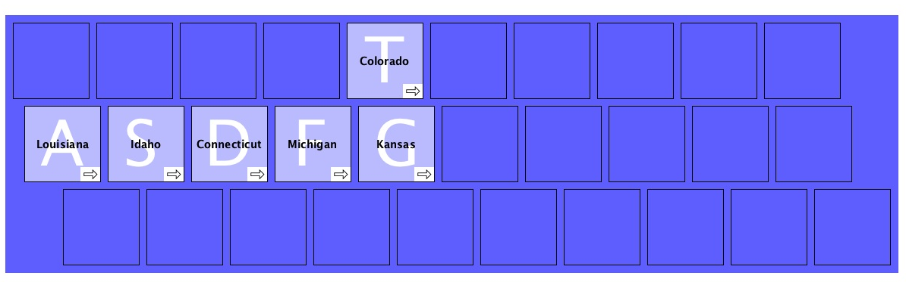
Keyboard-Card Menus

Slide 61
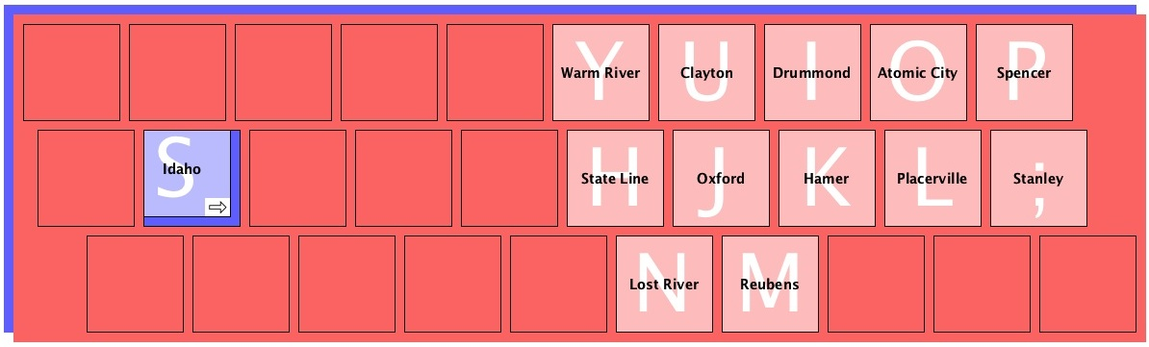
Keyboard-Card Menus
Notes:
One of the advantages is that if you don’t see what you are looking for in the submenu, all you have to do is, in this case, release the S key.
The big advantage, though, is that by selecting menu items one is actually physically rehearsing the process of invoking the shortcut.

Slide 62
Propositional Logic Syntax Shortcuts
Use keyboard-card menus to easily build up and edit a small subset of Coq’s language by navigating and manipulating templates
This subset consists of Fitch-style proofs in Classical Propositional Logic
I’m adding axioms to allow use of the natural deduction inference rules presented in Huth and Ryan’s Logic in Computer Science
This should allow the extension to be particularly useful in education

Slide 63
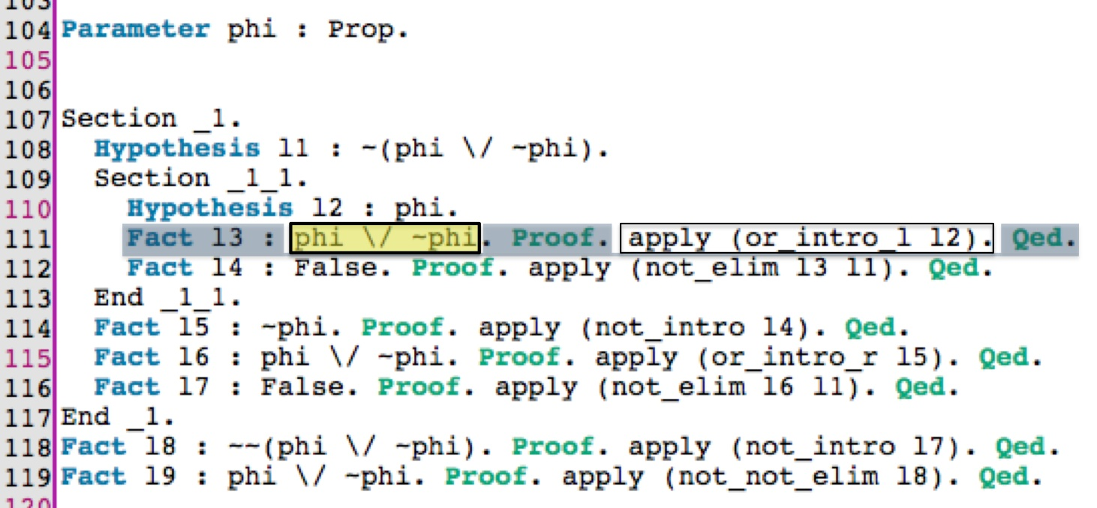
Propositional Logic Syntax Shortcuts

Slide 64
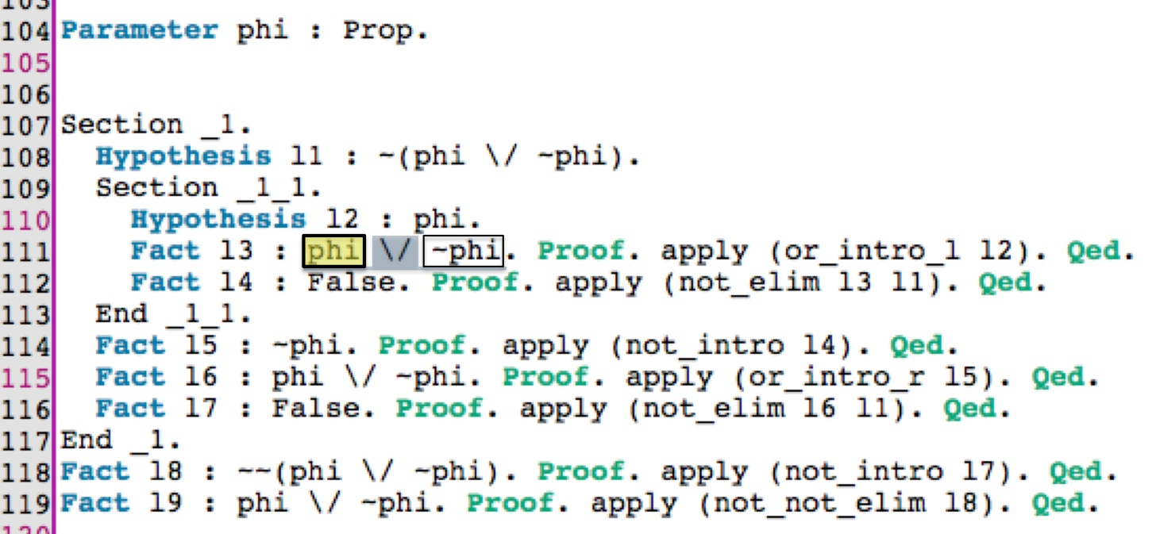
Propositional Logic Syntax Shortcuts

Slide 65
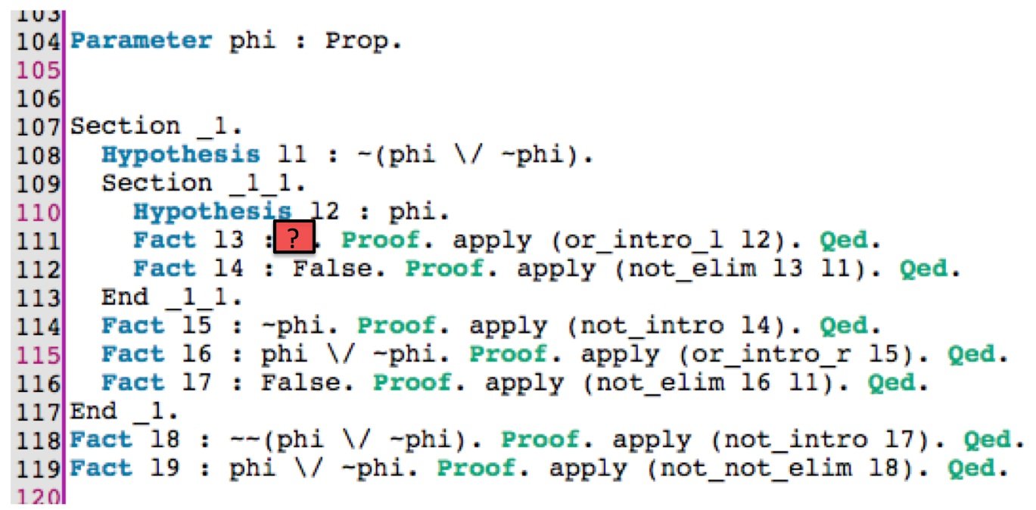
Propositional Logic Syntax Shortcuts

Slide 66
User Testing
Test Proof Previews and Proof Transitions with 16 new users (computer science students)
Train each participant for 45 minutes
Have each participant explain four complicated proofs they are given, two using Proof Transitions and two without
These explanations will be video recorded and graded
Have each participant prove up to 20 simple theorems, 10 with Proof Previews and 10 without, with up to 15 minutes for each set
Have participants fill out satisfaction/preferences questionnaire

Slide 67
Rough Schedule
Revised version of CoqEdit, the Proof Previews plugin, and the Proof Transitions plugin by September
Proof Previews/Transitions testing: September/October
Propositional Logic Syntax Shortcuts development: October-January
Further refinement of plugins, public release of plugins/source code/documentation, dissertation writing: February-April
Dissertation Defense: May

Slide 68
Thanks!

